Slide 1

מבני נתונים
תרגול 6 – ערמה
צבי מינץ – zvimints@gmail.com

Slide 2


What is a Binary Heap?
8
שורש העץ
0
7
6
2
3
3
2
5
4
5
6
4
Max Heap
Min Heap
עץ בינארי כמעט שלם
Notes:
So your next question probably is ‘what is a heap’?
I usually make up my own definitions, but I really like this one from Wiki.
Read slide.
What this means is that the value of parent node is always greater than or equal to the
value of the child node for all nodes or that the value of parent node is always less than
or equal to the value of the child node for all nodes. This means there are two types
of heaps max heaps and min heaps.
The following are binary heaps. Binary because every node has exactly two children, and
the children you cannot see are null values I haven’t drawn. On the left is a max heap
because for all nodes except the root the parent node has a value greater than or equal to its children.
Similarly on the right is min heap.
So why are we interested in heaps? Well heaps form the canonical underlying data structure for priority queues, so much so that priority queues are sometimes called heaps although this isn’t technically correct since a priority queue is an ADT meaning it can be implemented with other data structures also.

Slide 3
Binary Heap Representation
value
9 | 8 | 7 | 6 | 5 | 1 | 2 | 2 | 2 | 3 | 4 | 0 | 1 | 2 | 1
1 | 3 | 3 | 4 | 5 | 6 | 7 | 8 | 9 | 10 | 11 | 12 | 13 | 14 | 15
index
1
9
2
Index
Tree
3
8
7
4
5
6
7
6
5
1
2
8
9
10
11
12
13
14
15
2
2
3
4
0
1
2
1
Notes:
One last thing before we get into how to add values to our binary heap, I promise.
We need to understand how do we represent and construct one of these binary heaps.
Well, one of the most popular ways to represent a heap is by using an array because
of the complete tree property we talked about. This is however not the only way to
represent a heap we could also use objects and pointers and recursively add and
remove nodes as needed, but right now we’re going to look at the array based construction.
On the left is the index tree to help you visualize the position of each node in the array, and
on the right is the actual tree. Remark that as you read elements in the array from left to right
it’s as though you’re pacing through the heap one layer at a time from left to right.

Slide 4
Binary Heap Representation
value
9 | 8 | 7 | 6 | 5 | 1 | 2 | 2 | 2 | 3 | 4 | 0 | 1 | 2 | 1
1 | 3 | 3 | 4 | 5 | 6 | 7 | 8 | 9 | 10 | 11 | 12 | 13 | 14 | 15
index
1
9
2
Index
Tree
3
8
7
4
5
6
7
6
5
1
2
8
9
10
11
12
13
14
15
2
2
3
4
0
1
2
1
Notes:
One last thing before we get into how to add values to our binary heap, I promise.
We need to understand how do we represent and construct one of these binary heaps.
Well, one of the most popular ways to represent a heap is by using an array because
of the complete tree property we talked about. This is however not the only way to
represent a heap we could also use objects and pointers and recursively add and
remove nodes as needed, but right now we’re going to look at the array based construction.
On the left is the index tree to help you visualize the position of each node in the array, and
on the right is the actual tree. Remark that as you read elements in the array from left to right
it’s as though you’re pacing through the heap one layer at a time from left to right.

Slide 5
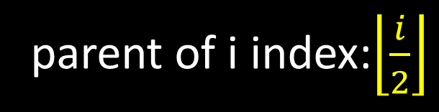
Binary Heap Representation
value
9 | 8 | 7 | 6 | 5 | 1 | 2 | 2 | 2 | 3 | 4 | 0 | 1 | 2 | 1
1 | 3 | 3 | 4 | 5 | 6 | 7 | 8 | 9 | 10 | 11 | 12 | 13 | 14 | 15
index
Let i be a node index
9
(one based)
8
7
Left child index: 2i
6
5
1
2
Right child index: 2i + 1
parent of i index:$\left\lfloor \frac{i}{2}\right\rfloor$
2
2
3
4
0
1
2
1
Notes:
One last thing before we get into how to add values to our binary heap, I promise.
We need to understand how do we represent and construct one of these binary heaps.
Well, one of the most popular ways to represent a heap is by using an array because
of the complete tree property we talked about. This is however not the only way to
represent a heap we could also use objects and pointers and recursively add and
remove nodes as needed, but right now we’re going to look at the array based construction.
On the left is the index tree to help you visualize the position of each node in the array, and
on the right is the actual tree. Remark that as you read elements in the array from left to right
it’s as though you’re pacing through the heap one layer at a time from left to right.

Slide 6
Binary Heap Representation
value
9 | 8 | 7 | 6 | 5 | 1 | 2 | 2 | 2 | 3 | 4 | 0 | 1 | 2 | 1
1 | 3 | 3 | 4 | 5 | 6 | 7 | 8 | 9 | 10 | 11 | 12 | 13 | 14 | 15
index
Let i be a node index
9
(one based)
8
7
Left child index: 2i
6
5
1
2
Right child index: 2i + 1
parent of i index:$\left\lfloor \frac{i}{2}\right\rfloor$
2
2
3
4
0
1
2
1
Notes:
One last thing before we get into how to add values to our binary heap, I promise.
We need to understand how do we represent and construct one of these binary heaps.
Well, one of the most popular ways to represent a heap is by using an array because
of the complete tree property we talked about. This is however not the only way to
represent a heap we could also use objects and pointers and recursively add and
remove nodes as needed, but right now we’re going to look at the array based construction.
On the left is the index tree to help you visualize the position of each node in the array, and
on the right is the actual tree. Remark that as you read elements in the array from left to right
it’s as though you’re pacing through the heap one layer at a time from left to right.

Slide 7
https://www.cs.usfca.edu/~galles/visualization/Heap.html
private void SwapUp(int index) // O(logn) - Insert
public void Heapify(int i) // O(logn) - Remove
public int getMin() // O(1)
public void build_heap(int[] A) // O(n)
public void heapsort(int[] A) // O(nlogn)

Slide 8
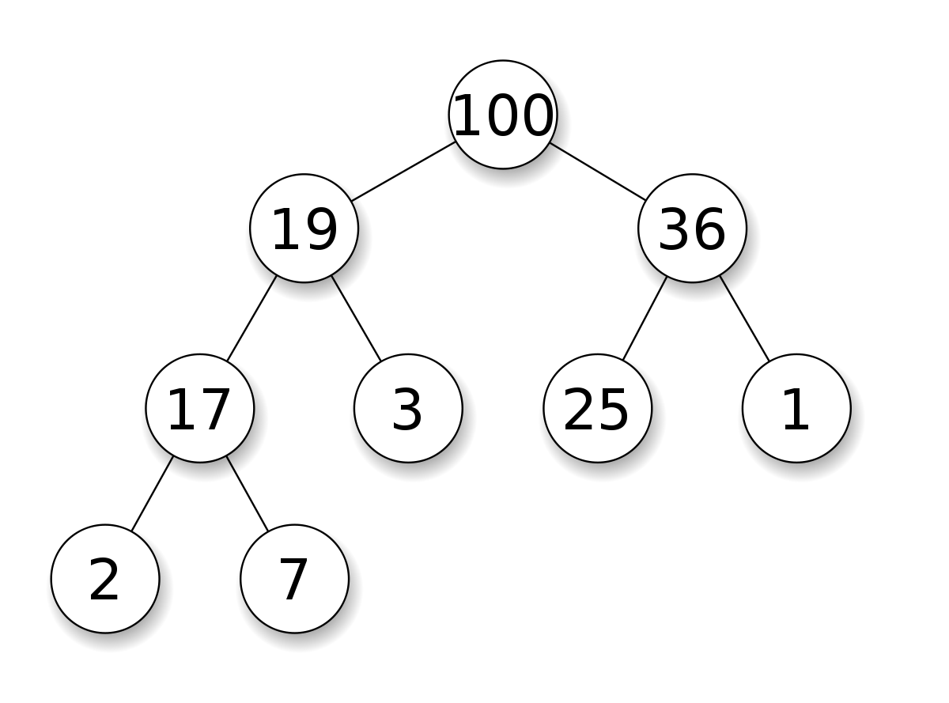
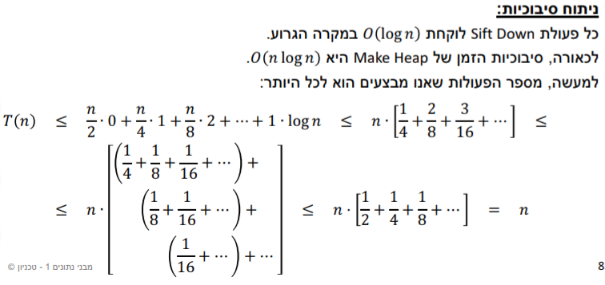
public void build_heap(int[] A) // O(n)

Slide 9

מימושMaxHeap.java
public class MaxHeap
{
…
}
צבי מינץ

Slide 10
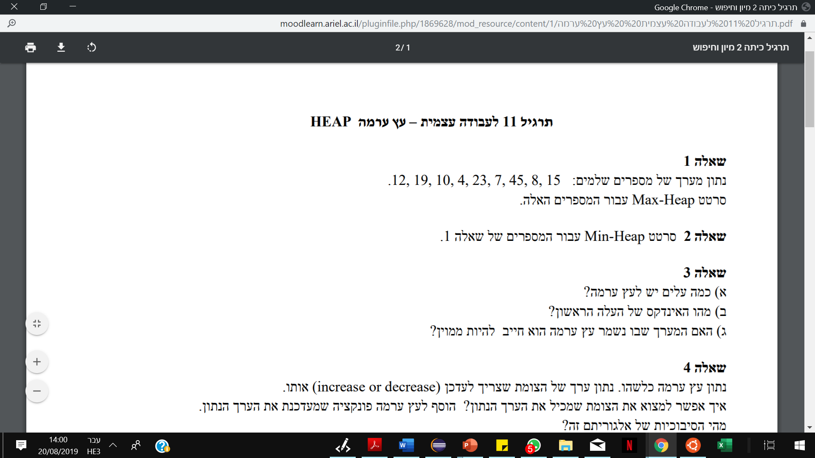
http://btv.melezinek.cz/binary-heap.html
צבי מינץ – zvimints@gmail.com

Slide 11
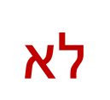
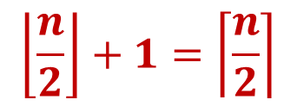

מאינדקס 1
$$\left\lceil \frac{n}{2}\right\rceil$$
$$\left\lfloor \frac{n}{2}\right\rfloor +1=\left\lceil \frac{n}{2}\right\rceil$$
$$לא$$
צבי מינץ – zvimints@gmail.com

Slide 12
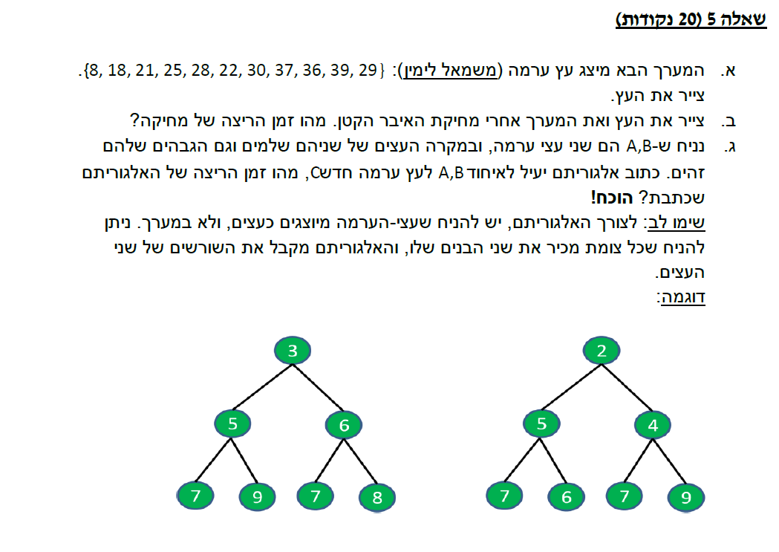
תרגיל בית
תרגיל בית
צבי מינץ – zvimints@gmail.com

Slide 13
// Merges max heaps a[] and b[] into arr[]
public static void mergeHeaps(int[] arr, int[] a,
int[] b, int n, int m) {
for (int i = 0; i < n; i++) {
arr[i] = a[i];
{
for (int i = 0; i < m; i++) {
arr[n + i] = b[i];
{
n = n + m;
// Builds a max heap of given arr[0..n-1]
for (int i = n / 2 - 1; i >= 0; i--) {
maxHeapify(arr, n, i);
  {
{
צבי מינץ – zvimints@gmail.com

Slide 14
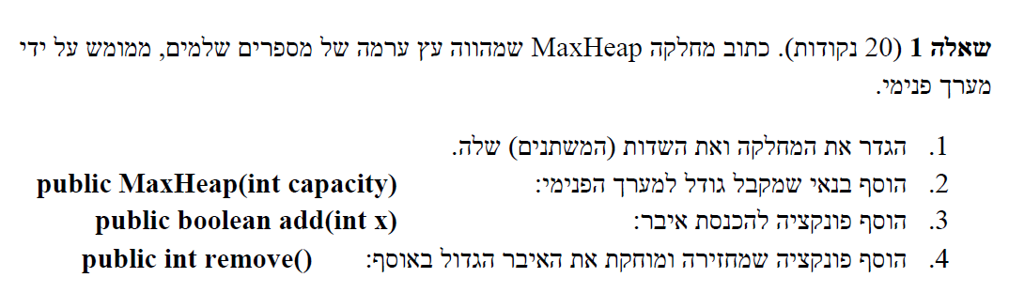
public class MaxHeap {}
צבי מינץ – zvimints@gmail.com

Slide 15
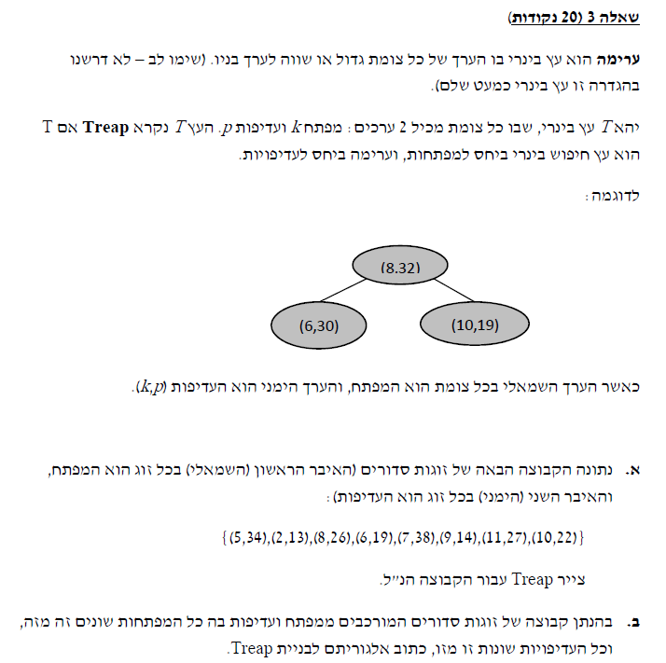
(2,13), (9,14), (6,19), (10,22),
(8,26), (11,27), (5,34), (7,38)
(7,38)
(5,34)
(11,27)
(2,13)
(8,26)
(6,19)
(10,22)
(9,14)
צבי מינץ – zvimints@gmail.com

